Slide 1
Putting Pediatric Palliative Care in Prime Time
Benefits, Value Proposition, Messaging, and Resources

Slide 2


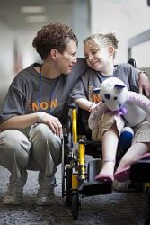
Starter Statement
Modern medicine has helped thousands of seriously ill infants and children live longer lives.
Pediatric Palliative Care (PPC) is essential to bring the same level of attention to the quality of these longer lives – for both the affected children and their families.
Notes:
Our ability to relieve the pain, symptoms, and stress of serious illness for infants, children and families has never been greater.

Slide 3
Palliative care value proposition
Putting Pediatric Palliative Care in Prime Time

Slide 4
Drawing on a Decisive Moment
Health system facing unprecedented growth of an aging population, and seriously ill adults, infants, and children are living longer with complex conditions
Documented failure to recognize and treat pain and other distressing symptoms
Exponential cost increases in care without improved value
Value-based care is taking over as the new mantra while MACRA implementation starts taking hold
Dissatisfaction and confusion about medical care and the health system
What if we intensify our focus on what matters to people?
Palliative care is an essential
health care innovation

Slide 5
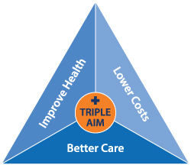

Palliative Care is a Solution
It delivers on the IHI triple aim framework:
Improves quality of life and prognostic understanding
  Relieves pain, distress, uncertainty
  Helps clarify and address patient and family goals and associated treatment preferences
Strengthens communication, decision-making and family satisfaction/well-being
Coordinates medical and practical needs across settings
Reduces resource utilization and costs by matching treatment to patient and family goals

Slide 6
Describing palliative care
Palliative care is a team-based specialty devoted to improving quality of life for seriously ill patients and families through:
Expert pain and symptom management
Skilled communication about what matters most to patients and their families
Well-coordinated care over the course of illness

Slide 7

Palliative care = quality care
It’s an essential aspect of providing the best care possible at any age, and should be delivered at the same time as curative or disease directed treatments.
“It’s like when you’re filling in concrete.
The transplanters are the people who put the layer down, then palliative care are the people who go after and fill the holes, so the whole thing doesn’t start to crumble.
But if it does start to crumble they’re the people who actually go with the hard hats and fix it.”
- Gwen Lorimer, The New Yorker Jan 2014

Slide 8


Bring Palliative Care Everywhere
It’s one of the fastest growing healthcare specialties for adult care in the US
It’s imperative to bring these same benefits to all seriously ill infants, children and families
It’s got to be reliably available in all the settings where children and families need care – inpatient, outpatient, home

Slide 9
PPC Improves Outcomes
Helps parents and children have a voice in identifying and realizing their care goals – essential to improved quality of life, experience and satisfaction
Enhances well-being, strength, and resilience – all required to have the reserve to undergo disease-directed treatment successfully
Makes it more likely that seriously ill children and their families have fun and meaning
Wolfe, J, Hammel, JF, Edwards, KE, et al. (2008). Easing of suffering in children with cancer at the end of life: Is care changing? Journal of Clinical Oncology, 26(10), 1717–1723.
Hays, RM, Valentine, J, Haynes, G, et al. (2006). The Seattle Pediatric Palliative Care Project: Effects on family satisfaction and health-related quality of life. Journal of Palliative Medicine, 9(3), 716–728.
Friedrichsdorf SJ, Postier A, Dreyfus J, Osenga K, Sencer S, Wolfe J. Improved quality of life at end of life related to home-based palliative care in children with cancer. J Palliat Med.
Notes:
Wolfe, J, Hammel, JF, Edwards, KE, et al. (2008). Easing of suffering in children with cancer at the end of life: Is care changing? Journal of Clinical Oncology, 26(10), 1717–1723.
Hays, RM, Valentine, J, Haynes, G, et al. (2006). The Seattle Pediatric Palliative Care Project: Effects on family satisfaction and health-related quality of life. Journal of Palliative Medicine, 9(3), 716–728.
Gans D, Hadler MW, Chen X, et al. Impact of a pediatric palliative care program on the caregiver experience. J Hosp Palliat Nurs 2015;17:559-565.
Friedrichsdorf SJ, Postier A, Dreyfus J, Osenga K, Sencer S, Wolfe J. Improved quality of life at end of life related to home-based palliative care in children with cancer. J Palliat Med.

Slide 10

Shown Also To Reduce Costs
California Home-Based PPC Pilot Findings:
High satisfaction scores from caregivers – improved children’s pain and other symptoms and parents’ own experience and quality of life
Health care cost savings of $3,331 PEPM
Most savings were realized through a dramatic reduction in inpatient costs of $4897 PEPM
Enrollees experienced a nearly 50% reduction in average number of inpatient days per month (dropped from 4.2 to 2.3)
Average LOS per hospitalization dropped from average 16.7 days before enrollment to 6.5 days while in the program
Overall savings totaled nearly $7 million. Pilot data spanned Jan 2010 to Dec 2012
Gans D, Hadler MW, Chen X, et al. Impact of a pediatric palliative care program on the caregiver experience. J Hosp Palliat Nurs 2015;17:559-565.
Gans D, Hadler MW, Chen X, et al. Cost Analysis and Policy Implications of a Pediatric Palliative Care Program. J Pain Symptom Manage. 2016;52(3):329-335.
Notes:
CONTEXT:
In 2010, California launched Partners for Children (PFC), a pediatric palliative care pilot program offering hospice-like services for children eligible for full-scope Medicaid delivered concurrently with curative care, regardless of the child's life expectancy.
OBJECTIVES:
We assessed the change from before PFC enrollment to the enrolled period in 1) health care costs per enrollee per month (PEPM), 2) costs by service type and diagnosis category, and 3) health care utilization (days of inpatient care and length of hospital stay).
METHODS:
A pre-post analysis compared enrollees' health care costs and utilization up to 24 months before enrollment with their costs during participation in the pilot, from January 2010 through December 2012. Analyses were conducted using paid Medicaid claims and program enrollment data.
RESULTS:
The average PEPM health care costs of program enrollees decreased by $3331 from before their participation in PFC to the enrolled period, driven by a reduction in inpatient costs of $4897 PEPM. PFC enrollees experienced a nearly 50% reduction in the average number of inpatient days per month, from 4.2 to 2.3. Average length of stay per hospitalization dropped from an average of 16.7 days before enrollment to 6.5 days while in the program.
CONCLUSION:
Through the provision of home-based therapeutic services, 24/7 access to medical advice, and enhanced, personally tailored care coordination, PFC demonstrated an effective way to reduce costs for children with life-limiting conditions by moving from costly inpatient care to more coordinated and less expensive outpatient care. PFC's home-based care strategy is a cost-effective model for pediatric palliative care elsewhere.
Provided home-based therapeutic services 24/7 access to medical advice and enhanced, personally tailored care coordination.
Savings of $3331 PEPM was result of dramatic decrease in inpatient costs, operationalized through major reductions in frequency and length of hospitalizations and relatively smaller increase in outpatients costs. More than ¾ of children were from ethnic minority populations.

Slide 11
Sizeable Numbers Need PPC
Infants and children with medical complexity are increasing in prevalence
Childhood deaths in US total 40,000 annually, and more than half occur in infancy
Estimates on numbers of US children currently living with complex conditions range from 400,000 and up
As many as 17 million adults are caregivers for a seriously ill child

Slide 12
Caring for Infants and Children: Unique Qualities and Challenges
Patients’ ages range from infants to young adults
Present with wide-ranging diagnoses, developmental stages and symptom burden
Course of care may stretch many months or years, and also supports siblings, parents and extended family
Parents are integrally involved in decisions in best interest of child with child’s involvement in process increasing with age

Slide 13

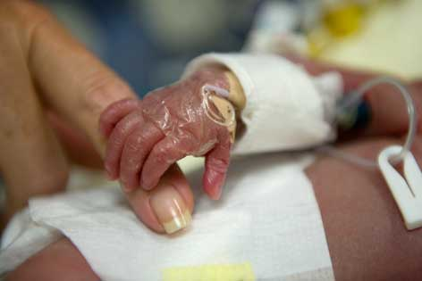
Who delivers it?
Everyone
Generalist palliative care
Basic symptom management and communication all clinicians should provide to achieve goal concordant treatment and QOL
Specialized team consultation
For more complex cases – refractory symptoms, challenging care planning and communication
TE Quill and AP Abernathy. Generalist plus Specialist Palliative Care —
Creating a More Sustainable Model. N Engl J Med 2013; 368:1173-1175
Action step: Prioritize professional education and training in primary palliative care core competencies for all clinicians
Communication skills (prognosis, goals of care, transitions)
Pain & symptom management
Sensitivity to cultural and spiritual beliefs
Grief and bereavement care

Slide 14
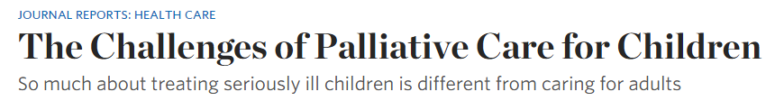
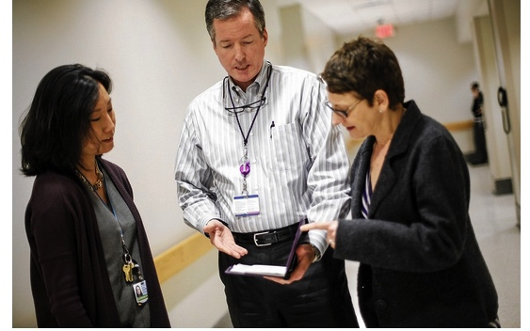
Addressing barriers to implementing PPC in practice:
Improve communication about what it is and its benefits
Align research and resources with patient and family needs
Build specialist and generalist workforce through training
Expand access to services in all settings, including community-based (e.g., outpatient and home) where most seriously ill children receive care
Notes:
http://www.wsj.com/articles/the-challenges-of-palliative-care-for-children-1424145655

Slide 15
Effective messaging about palliative care

Slide 16
What’s in a name? Messaging matters.
People Want Palliative Care:
95% say education is important for patients & their families about palliative care options available to them as part of treatment.
92% report they would be likely to consider palliative care for themselves or their families if they had serious illness
92% also said they believe patients should have access to palliative care at hospitals nationwide
Palliative care…
Focuses on relieving symptoms, pain and stress of serious illness.
Improves quality of life for both patient and family.
Provided by a team who works with a patient’s other doctors to provide an extra layer of support.
Appropriate at any age and any stage and can be provided along with curative treatment.
CAPC Public Opinion Strategies research and national survey of 800 adults age 18+ conducted June 2011.
Notes:
Key consumer research takeaways:
Changing the name isn’t necessary
Palliative care is a relative unknown among consumers
People understand and want palliative care if we use their words to define & describe it
Use consistent QOL messages proven to work and they will stick
Access report summary with key findings at: www.capc.org.

Slide 17
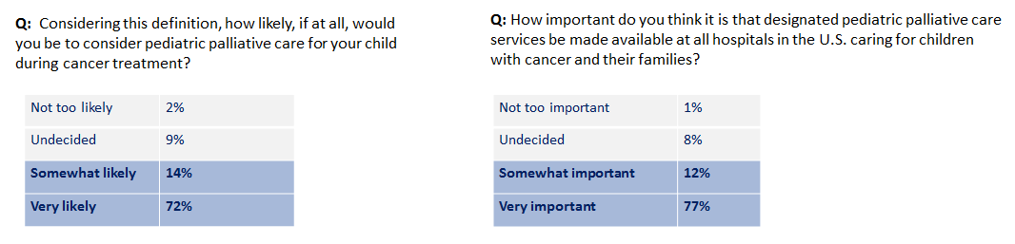
Give parents the words to use
October 2014 American Childhood Cancer Organization online survey (n=275 parents) used these same messages:
86% would be likely to consider PPC for their child during cancer treatment
89% think its important that PPC services are available in all hospitals caring for children
http://meetinglibrary.asco.org/content/103464?media=vm&poster=1
Notes:
Use “palliative care” term consistently and this consumer-driven definition to explain it as an essential part of optimal care

Slide 18
Helping chronically ill children
PPC adds an extra layer of support for seriously ill children and their families, using an interdisciplinary team approach to provide holistic, compassionate, and individualized care.
Through this partnership, PPC adds value not only to the children and families, but also to the multiple primary and subspecialty clinicians caring for them.
A key part of PPC expertise involves knowing how to negotiate complex care waters by improving communication and collaboration to deliver better care for the child and family.

Slide 19
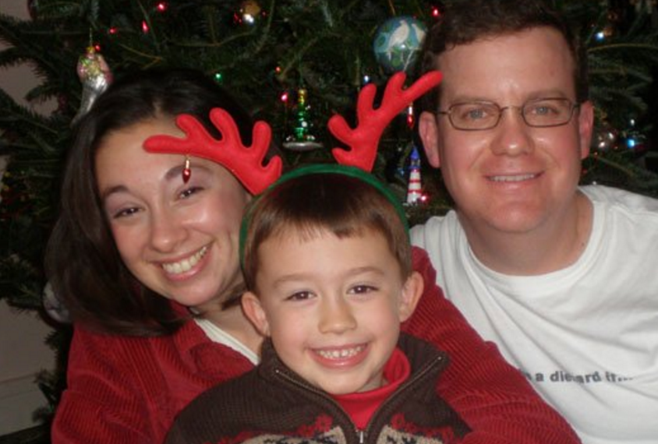
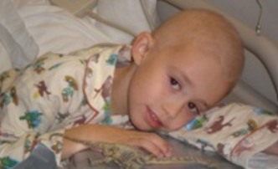
Hope has many constellations
“Once I found out we were dealing with EOL care, I did have hope.
Hope changes along the continuum.
When hope for a cure went out the window, then we hoped for a more sound, humane, and less painful death.
Empowerment and communication go hand in hand.”
Victoria Sardi-Brown
Mattie’s Mother
Mattie Miracle Cancer Foundation

Slide 20
EXPAND integrated programs and access

Slide 21
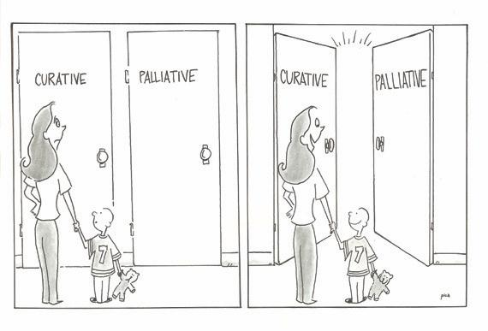

PPC Access Affirmation
Pediatric Palliative Care and Hospice Care Commitments, Guidelines, and Recommendations (October 2013)
PPC is an essential aspect of medical care for patients who have life-threatening conditions or need end-of-life care
All clinicians should provide basic palliative care initiated at diagnosis and consult PPC-PHC specialists in a timely manner to deliver “collaborative integrated multimodal care” (i.e., concurrent curative care)
Notes:
ACA’s federal concurrent care waiver has the potential to have a significant positive impact on quality EOL care delivery for children with life-limited illnesses. If implemented through state Medicaid agencies, it would eliminate provider challenges denying concurrent curative and palliative therapies for eligible children.
But physician must still certify the child is within last 6 months of life.

Slide 22
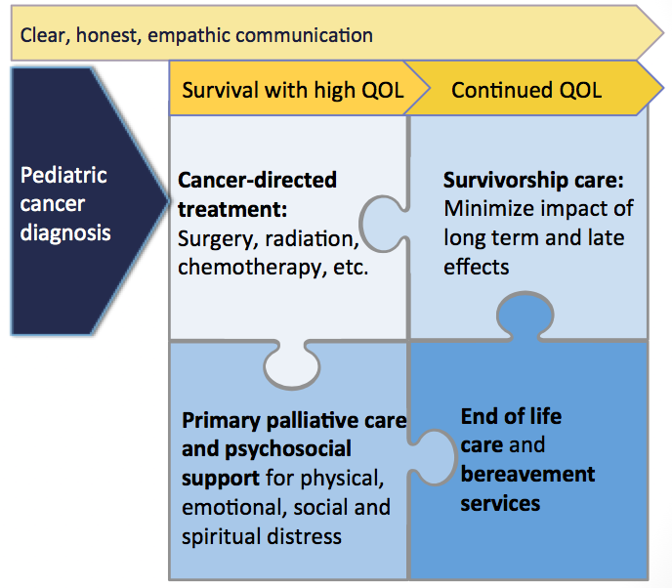

Comprehensive Cancer Care
Kirch R, Reaman G, Feudtner C, et al. Advancing a comprehensive cancer care agenda for children and their families: Institute of Medicine Workshop highlights and next steps. CA: A Cancer Journal for Clinicians 2016 Sep;66(5):398-407.

Slide 23
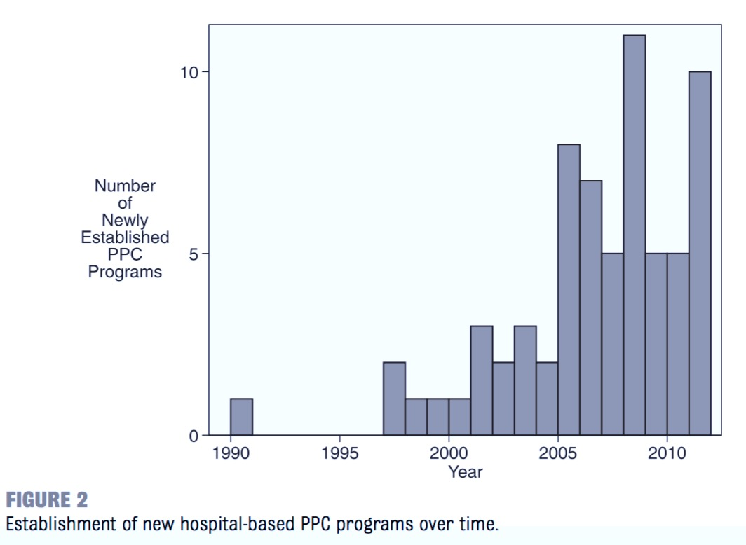
Rising number of PPC teams
PPC 2013 cross-sectional national survey revealed that 69% of children’s hospitals have a team (112/162)
(Feudtner et al. Pediatrics 2013)
BUT…
Nearly one-third hospitals still lack PPC
Most only offer inpatient service during work week and are highly dependent on hospital funding
Need to also expand community-based access and develop sustainable financial models
Number of consults annually varied substantially across programs, positively associated with hospital bed size and number of funded staff
Notes:
Rate of new PPC program creation peaked in 2008, with 12 new programs created that year, and 10 new programs in 2011

Slide 24
Culture of Quality
Small staff building new PPC service in hospital
Full team staffed; services extend to community; may offer fellowship training
Team growing in size and reach, increasing # consults – inpatient/outpatient
Early startup Mature
To ensure quality and safety, PPC teams should strive to:
Include physicians, nurses, social workers, case managers, spiritual care providers, bereavement specialists, and child life specialists
Have an adequate number of dedicated, trained staff who are available for consultation 24-7 and are paid specifically to provide PPC
Bridge their consultative activities across multiple physical locations to support patients, ranging from provision of services in homes or schools to clinics, hospitals, and other partnering facilities
Conduct ongoing quality improvement reviews and projects aimed at improving patient and family experiences and outcomes
(AAP Guidelines, Pediatrics 2013)
Notes:
PPC programs often begin with only a few team members, increasing staff and services over time.

Slide 25
Additional resources

Slide 26



New PPC Resources Field Guide
CAPC PPC Field Guide digital tool includes links to key info from multiple organizations and sources covering:
PPC’s Value Proposition: Making the Case
Building and Expanding Integrated Programs
Collaboration with the Research Community
Advocacy for System Level Change
Access PPC Field Guide at www.capc.org

Slide 27

New CAPC PPC Content
This slide deck and field guide – use these to update your colleagues and other audiences
National Palliative Care Registry includes PPC-specific reports capacity to compare programs
CAPC Pediatric Toolkit online tools and technical assistance for CAPC members
PCLC-Pediatric will be expanding to more sites with updated and expanded content in 2017

Slide 28


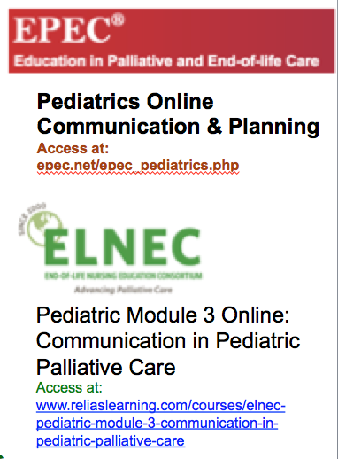
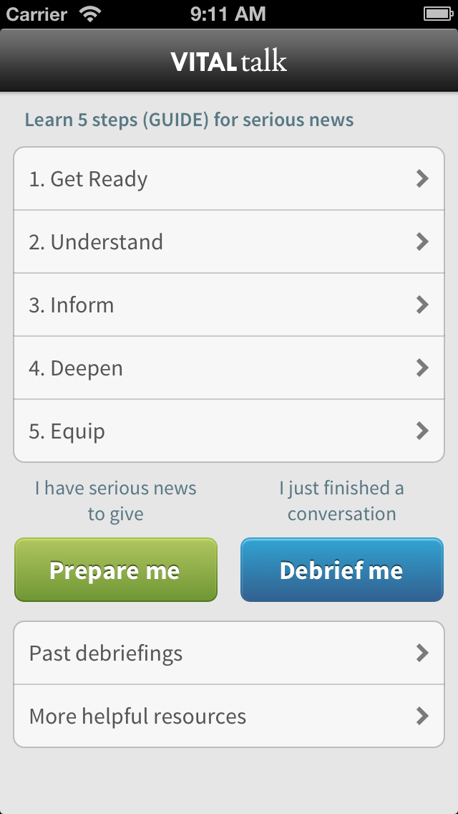

Skills Development Scaffolding
CAPC's Communication
Curriculum
https://www.capc.org/capc-central/courses/
Access free online tools for clinicians and faculty at www.vitaltalk.org
Notes:
We need to equip clinicians AND empower patients/families at same time to change the culture of QOL communication.

Slide 29

Always Ask Tattoo
Pick a Few QOL Cues:
Tell me about your child as a person
How do you like to get medical information?
What is your understanding of your child’s situation now?
What is important to you?
What are you hoping for/what are your worries?
Where do you find your strength/comfort?
APPLY HERE

Slide 30

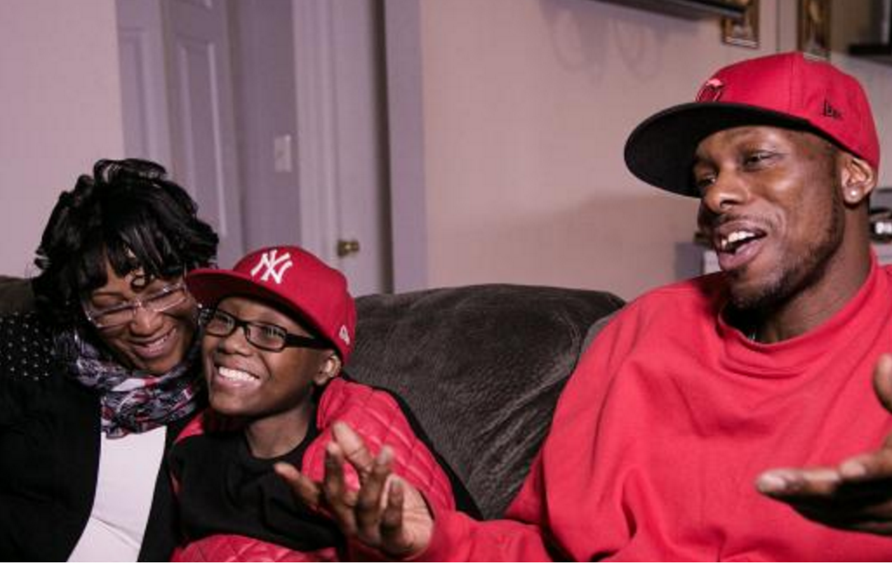

Giving people the words to use
Transforming anxiety about dying into
conversations about living
Access helpful videos and other info at
common-practice.com
Rx: Playing the game creates a safe place for everyone to talk about QOL priorities and goals

Slide 31





Additional Resources
Courageous Parents Network (courageousparentsnetwork.org)
Get Palliative Care consumer information (getpalliativecare.org/whatis/pediatric/
Voicing My Choices (agingwithdignity.org/shop/product-details/voicing-my-choices)
NIH/NINR Conversations Matter campaign (ninr.nih.gov/newsandinformation/conversationsmatter/pccm-about-7-2015#.Vjktf66rRPM)
Parent’s Guide to Enhancing QOL in Children with Cancer family handbook (accc.org)

Slide 32
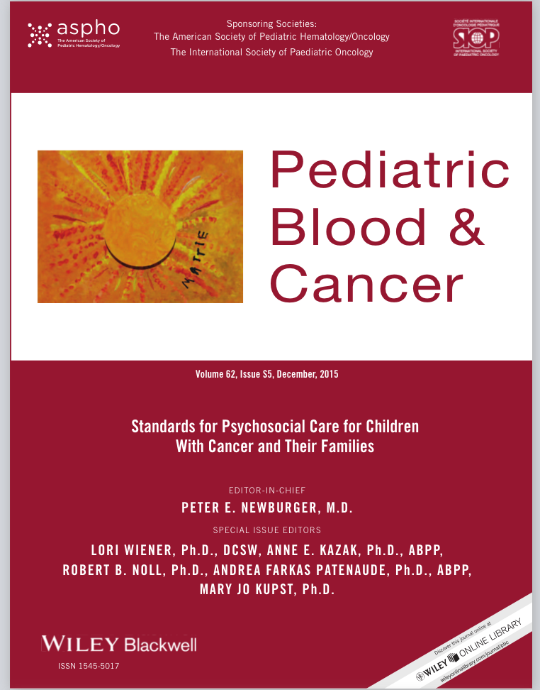
Psychosocial Care Standards
15 STANDARDS OF CARE
http://www.mattiemiracle.com/downloadstandards
Psychosocial Assessment
Monitoring and Assessment of Neuropsychological Outcomes
Psychosocial Follow-Up in Survivorship
Psychosocial Interventions and Therapeutic Support
Assessment of Financial Burden
Standards of Psychosocial Care for Parents of Children with Cancer
Anticipatory Guidance and Psycho-education
Procedural Preparation and Support
Providing Children and Adolescents Opportunities for Social Interaction
Supporting Siblings
Academic Continuity and School Reentry Support
Assessing Medication Adherence
Palliative Care
Bereavement Follow-Up After the Death of a Child
Communication, Documentation, and Training Standards in Pediatric Psychosocial Oncology
Link to full issue: http://www.mattiemiracle.com/?utm_campaign=2016%2BMay%2BNewsletter&utm_medium=email&utm_source=Mattie%2BMiracle%2BMay%2BNewsletter%2B2016#!downloadstandards/c1dja
Notes:
Link to full issue: http://www.mattiemiracle.com/?utm_campaign=2016%2BMay%2BNewsletter&utm_medium=email&utm_source=Mattie%2BMiracle%2BMay%2BNewsletter%2B2016#!downloadstandards/c1dja

Slide 33

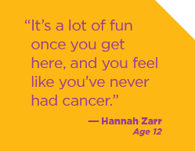


Care Camps: Healing happens here
Care camps = a powerful palliative care prescription that boosts QOL for children, families, and health professionals
Camp locator map:
http://www.cocai.org/index.php/component/geofactory/?view=map&id=4
Notes:
Martiniuk, A., Silva, M., Amylon, M. and Barr, R. (2014), Camp programs for children with cancer and their families: Review of research progress over the past decade. Pediatr. Blood Cancer, 61: 778–787. doi: 10.1002/pbc.24912
Wu YP, McPhail J, Mooney R, Martiniuk A, Amylon MD. A multisite evaluation of summer camps for children with cancer and their siblings. Journal of psychosocial oncology. 2016:1-11.

Slide 34

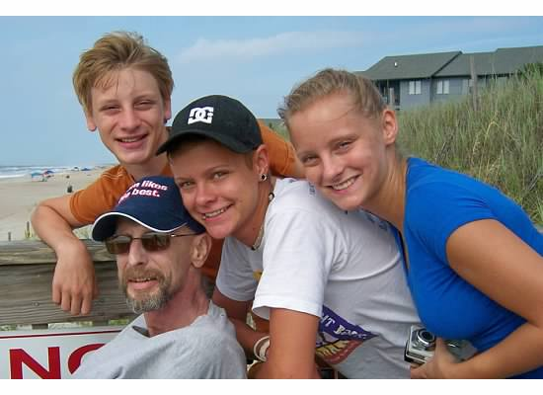
Insurance Coverage and Financial Assistance Advocacy
200 caring case managers provide individualized and sustained services by phone
Active liaisons between the patient or parent and their insurer, employer and/or creditors
Free assistance to resolve insurance, job retention and/or debt crisis matters
Families can contact PAF at 1-800-532-5274 or email an online case manager directly

